Slide 1
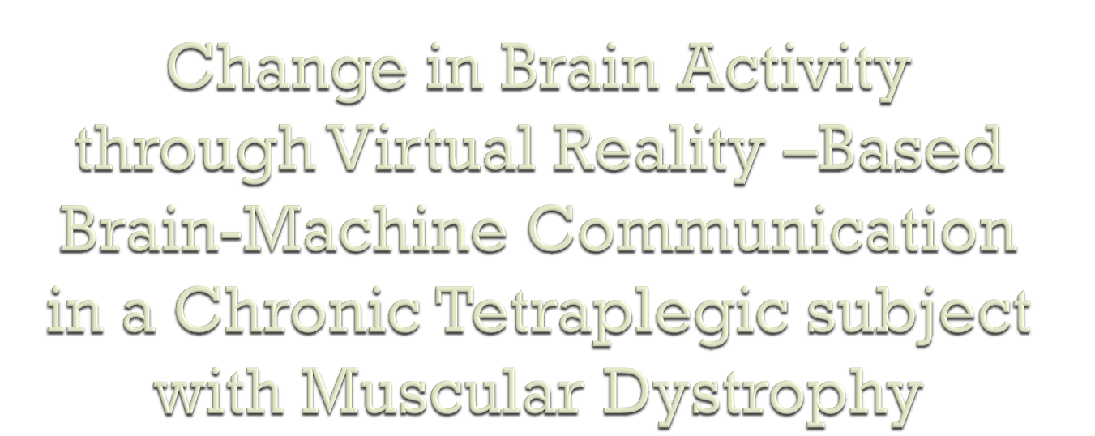
Yasunari Hashimoto, Junichi Ushiba, Akio Kimura, Meigen Liu, Yutaka Tomita
BMC Neuroscience (2010),11:117
Presenter: Saumya Puthenveettil

Slide 2

To investigate the long-term effects of BCI use on brain activities in MD subjects
To deliver e-communication opportunities for paralyzed individuals

Slide 3

EEG-based BCI’s recognize intention-induced changes (imagined movement) in ongoing EEG signals to translate different mental states into commands for operating external devices
Second Life is an internet based VR environment where users operate their own avatar and communicate via a voice chat function

Slide 4

EEG changes in the form of ERD/ERS
Event related desynchronization (ERD)- activated state with enhanced processing of information in a specific system, increased excitability of cortical neurons
Event related synchronization (ERS)- deactivated state with reduced information processing in a specific system, decreased excitability of cortical neurons.

Slide 5

41-year-old tetraplegic subject suffered from severe MD for more than 30 years
EEG signals recorded motor intentions (MIs) using 3 bipolar surface electrodes (Cz, C4, C3)
Mu (8-13 Hz) and Beta [18-40 Hz) frequency bands were selected from the EEG rhythmic activity
3 different types of motor intentions (MIs) were developed to operate an avatar (Feet/Left-hand/Right-hand)
Feet MI detected with Beta band of foot representation area (Cz)
Hand MI detected with Mu and Beta of hand representation area (C4 & C3 )
Study duration of 5 months, 9 training sessions

Slide 6

For every sample, spectral power (“band power” [BP]) is calculated from Mu and Beta frequency bands by applying a Butterworth filter of order 4, squaring, averaging samples over 1 s, and computing logarithm from samples.
For Feet MI BCI is designed to detect MI with one threshold detector
Left-Right Hand MI detected with two threshold detectors and Fisher’s Linear Discriminant Analysis (LDA)

Slide 7

Session for LDA classifier initial setting:
40 trials in each pre/post avatar-control training session
20 random left or right hand MI
Trial to set initial LDA setting
4 sec of a fixation cross at the center of computer screen
1 sec cue (left or right hand MI task)
Subject imagines the respective hand movement for 5 sec
3 sec blank screen

Slide 8
BP for each Mu and Beta in C3 and C4 is calculated (same as previous) and LDA was performed for 40 sessions (elements: Mu BP at C3 and C4 and Beta BP at C3 and C4) for every time point.
Classification error rate over time is calculated using 10-fold cross-validation

Slide 9

1 hour training
Beta BP at Cz and the LDA classifier for hand MI were converted to feedback bars in real time
When feedback bars exceeded the manually input thresholds, a keyboard command signal for specific MI type is sent to system (move forward, left rotation, right rotation)

Slide 10
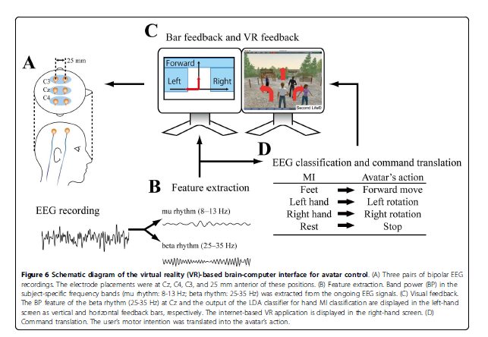


Slide 11

27 scalp electrode recordings conducted on pre-and post training days in sensorimotor area
Cue-paced sessions for feet, left-hand, and right-hand Mis
5 sessions, 30 trials each, (50 repetitions for each MI task)
EEG is filtered and band power is computed using a Fast Fourier Transform
ERD/ERS = (power during rest-power during experimentation)/(power during rest)
Brain Electrical Source Analysis Software Version 5.1.8

Slide 12

Decrease in error rate pre and post training
Increase in Receiving Operating Curves (ROC)
Plastic changes in EEG topography by long-term BCI use

Slide 13

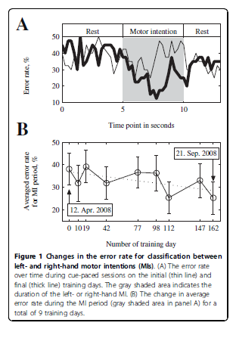
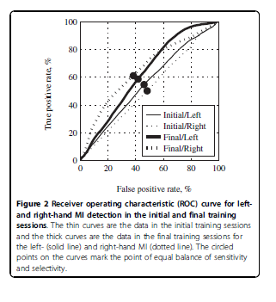

Slide 14
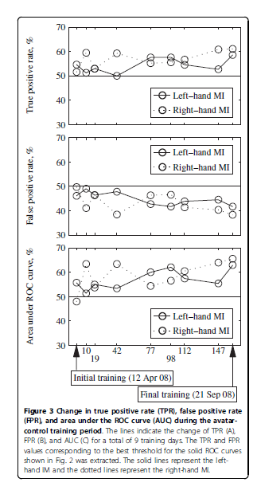

Slide 15
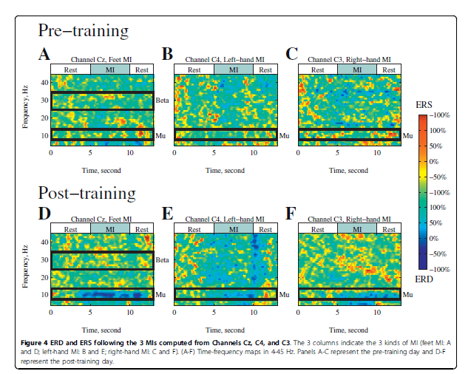

Slide 16
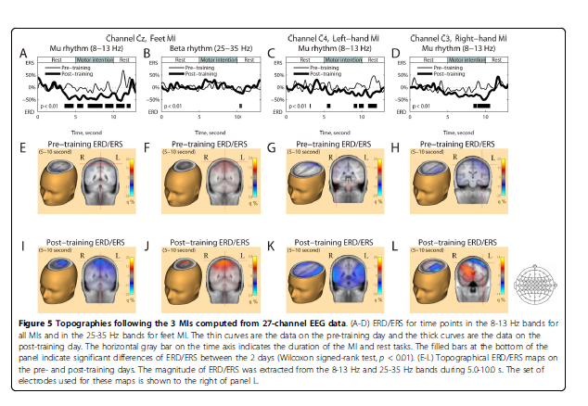

Slide 17

Subject had not moved his feet in 30 years but was able to change his EEG patterns and accuracy (sensorimotor cortex plasticity)
Subject successfully walked and chatted with other users in the VR environment while operating the BCI at home
VR systems can be developed to help severely paralyzed individuals communicate with others in a virtual world

Slide 18

Neuper C, Scherer R, Reiner M, Pfurtscheller G: Imagery of motor actions:differential effects of kinesthetic and visual-motor mode of imagery in single-trial EEG. Brain Res Cogn Brain Res 2005, 25:668-677
Müller-Putz GR, Scherer R, Pfurtscheller G, Rupp R: EEG-based neuroprosthesis control: a step towards clinical practice. Neurosci Lett 2005, 382:169-174.

